Slide 1
AHIM
Intelligent Supply Chain
for Modern Healthcare
AI-Powered Hospital
Inventory Management
A full-stack ML platform that eliminates drug shortages,
reduces expiry waste, and optimises hospital procurement
through real-time AI-driven predictions.
Team Members
Tenzin Kunga
23BTRCL088
Saunak Mahapatra
Academic Project
Full-Stack
ML-Powered
CrewAI Agents
23BTRCL077
Saumitra Purkayastha
23BTRCL113
github.com/tampered-sin/v0-ahimp | branch: develop

Slide 2
Presentation Contents
01
Problem Statement
06
AI & Predictive Analytics
Why hospital inventory needs disruption
LightGBM · CatBoost · LSTM · Ensemble · SHAP
02
Introducing AHIM
07
AI Agent System
Platform overview and core capabilities
CrewAI + Ollama3 autonomous supply chain agents
03
System Architecture
08
Backend & API
Full-stack design, folder structure, Docker
35+ REST endpoints, Docker, explainability layer
04
Technology Stack
09
Development Workflow
Frontend · Backend · ML · Data & Infra
Epics, sprints, Git branching, Definition of Done
05
Key Features
10
Conclusion & Roadmap
Dashboard, inventory, suppliers, departments, alerts
Industry impact, results, and future upgrades

Slide 3
01
Problem Statement
Why hospital inventory management needs disruption

Slide 4
The Challenge — Hospital Inventory Management
50%+
8–10%
20–30%
20–30%
$1B+
Hospitals cancel
procedures due to
drug shortages
Of supplies wasted
due to expiry
each year
Annual budget
locked in excess
inventory
Carrying cost
per year on
excess stock
Wasted annually
across US hospital
supply chains
Root Causes
Impact on Patient Care
Manual, spreadsheet-based tracking
Treatment interruptions from stockouts
No predictive demand forecasting
Medication errors from poor tracking
Siloed supplier management
Emergency procurement at premium cost
No real-time expiry monitoring
Compromised care outcomes
Reactive procurement (post-stockout)
Staff time lost to manual processes

Slide 5
02
Introducing AHIM
Platform overview and core capabilities

Slide 6
Introducing AHIM — What It Is & What It Solves
A modern full-stack AI platform that brings real-time monitoring, ML predictions
and autonomous CrewAI agents to hospital supply chain management.
By the Numbers
680+
7.3M
Centralized Dashboard
Real-time KPIs — 680+ items, low stock, expiring soon, $120M+ inventory value at a glance
Items monitored
Records in dataset
Smart Alert System
Severity-graded alerts (Critical/High/Medium/Low) with item name, qty, reorder level, expiry date
ML Prediction Layer
35+
<50ms
14-day demand forecasts + stockout risk + expiry risk — served to UI as FastAPI REST endpoints
AI Agent Automation
REST API endpoints
Model inference p99
CrewAI + local Ollama3 (llama3) auto-creates POs, scores suppliers, tracks deliveries end-to-end
SHAP Explainability
Every prediction backed by SHAP + LIME explanations — visible to pharmacists and clinicians in UI
DB → FastAPI → ML Models → Agents → Next.js
Full-Stack Data Flow

Slide 7
03
System Architecture
Full-stack design, folder structure & Docker deployment

Slide 8
System Architecture — Full-Stack Design & Data Flow
PostgreSQL 15
FastAPI Backend
ML Models
AI Agents
Next.js Frontend
14-table schema
~7.3M records
SQLite dev fallback
SQLAlchemy ORM
Lifespan events
Auto seed & train on startup
LightGBM · CatBoost
Random Forest · LR
LSTM · Isolation Forest
CrewAI + Ollama3
Data Ingestion Agent
Supply Chain Agent
App Router
React 19 + TypeScript
Tailwind CSS
->
->
->
->
Folder Structure (backend/)
Docker Deployment (docker-compose up --build)
main.py — FastAPI app, auto-trains on startup
1. Start PostgreSQL container
database/ — schema.sql · ORM models · seeder (14 tables)
2. Create database & 14 tables
data/ — feature_engineering.py · sequence_generator.py
3. Seed ~7.3M consumption records
models/ — demand · lightgbm · catboost · stockout · expiry · SHAP
4. Train all ML models (<5 minutes)
agents/ — supply_chain · data_ingestion · delivery_tracker · sentiment
5. Serve API at http://localhost:8000
api/ — 35+ endpoint modules (demand · stockout · agents · POs…)
Interactive docs at /docs

Slide 9
04
Technology Stack
Frontend · Backend · ML Models · Data & Infrastructure

Slide 10
Technology Stack — Libraries, Frameworks & Tools
Frontend
Backend
ML & AI
Data & Infra
Next.js 15
FastAPI
LightGBM 4.0
PostgreSQL 15
App Router, SSR, file-based routing
High-performance async REST API
Demand forecast (R²=0.9998)
Primary production database
React 19 + TypeScript
SQLAlchemy
CatBoost 1.2
SQLite
Scalable component architecture
ORM for PostgreSQL + SQLite
Categorical-native predictions
Local dev fallback (no Docker)
Tailwind CSS
Uvicorn / Gunicorn
Random Forest
Optuna
Utility-first, accessible UI
ASGI production server
Stockout risk classifier
Bayesian hyperparameter tuning
Recharts
Pydantic
TensorFlow/Keras
Pandas + NumPy
Dashboard data visualizations
Request validation & schemas
LSTM/GRU time-series model
Feature engineering pipelines
shadcn/ui
Docker Compose
SHAP + LIME
Isolation Forest
Accessible component primitives
One-command full-stack startup
Model explainability layer
Anomaly detection in ingestion

Slide 11
05
Key Features
Dashboard · Inventory · Suppliers · Departments · Alerts

Slide 12
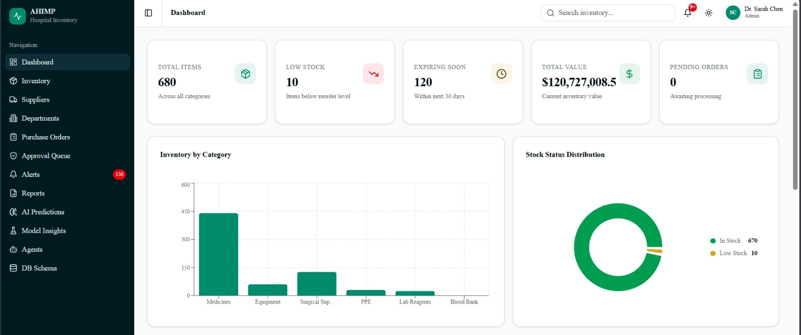
Key Feature — Main Dashboard
Real-time KPI overview for the entire hospital inventory
Shows Total Items (680), Low Stock (10), Expiring Soon (120), Total Value ($120.7M), Pending Orders — plus category bar chart, stock status donut, and ML-flagged at-risk items surfacing directly on screen.
Real-time KPI cards
Category breakdown chart
Stock status donut
ML-powered risk feed

Slide 13
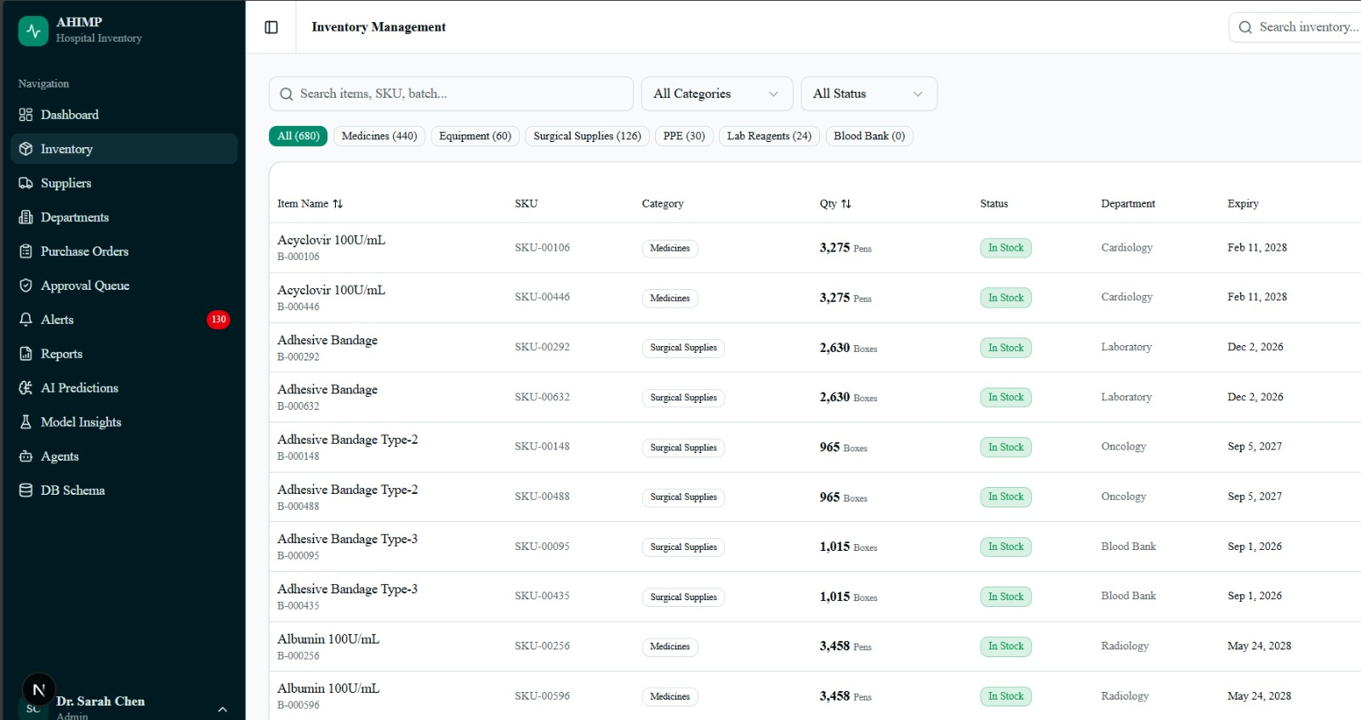
Key Feature — Inventory Management
Full catalogue with inline status, filters and item drill-down
Browse 680+ items across Medicines, Equipment, Surgical Supplies, PPE, Lab Reagents and Blood Bank. Each row shows stock status badge, unit price, quantity, expiry date and reorder level. Click any item for full consumption history.
Status badge per item
Expiry + reorder level
Filter by category
Drill-down detail view

Slide 14
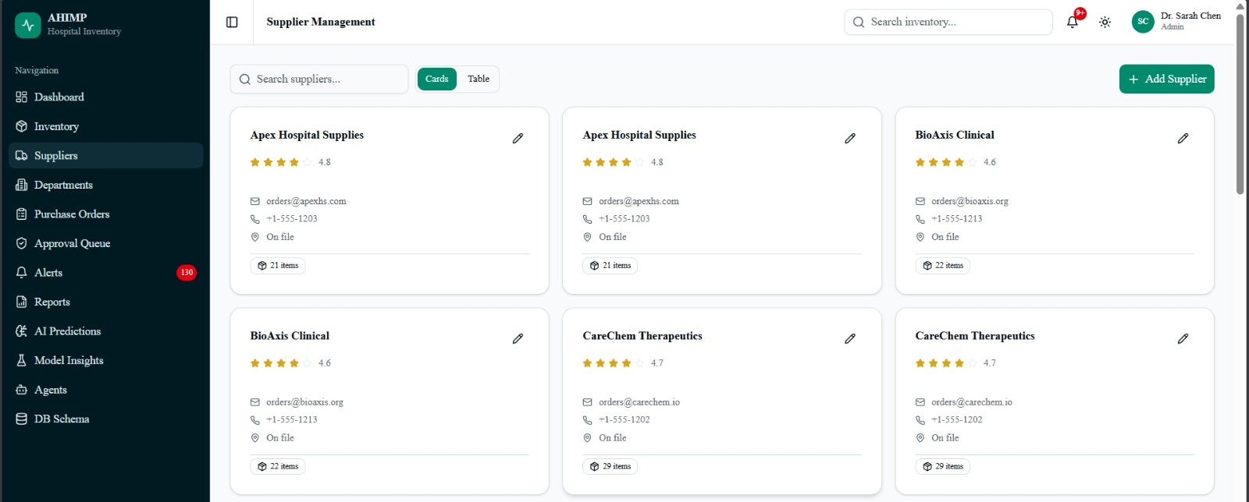
Key Feature — Supplier Management
AI-scored supplier directory with PO integration and NLP review analysis
Supplier reliability computed from: on-time delivery (25%), price competitiveness (20%), distance penalty (15%), reliability score (30%), and NLP sentiment of supplier reviews (10%). Weighted scoring drives automated PO supplier selection.
5-factor weighted scoring
NLP review sentiment
Lead-time tracking
One-click PO creation

Slide 15
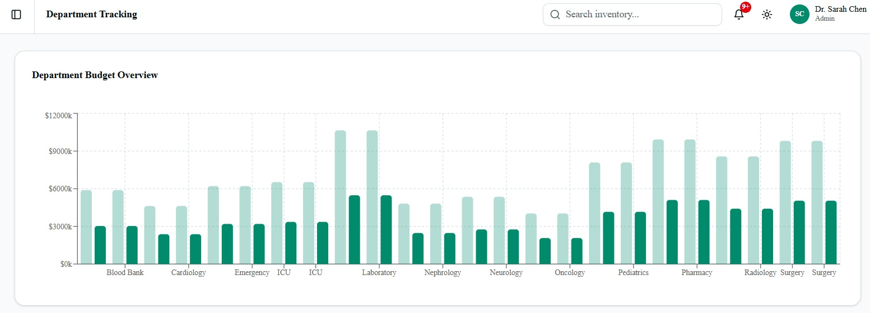
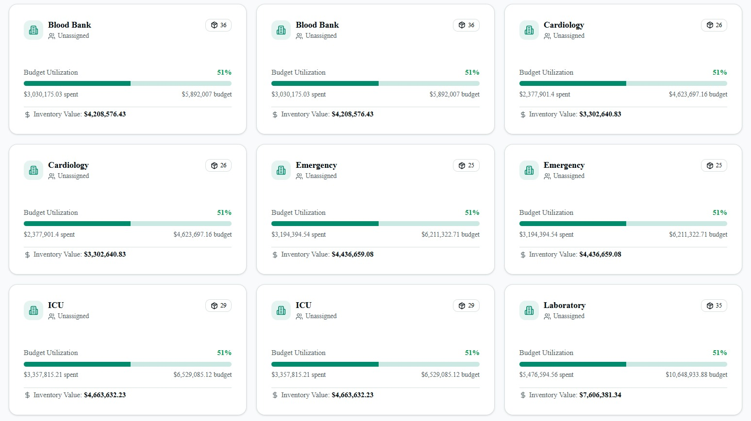
Key Feature — Department Budget Tracking
Budget utilization and actual spend analytics per ward/department
Each department's allocated budget vs actual spend visualised with bar charts. Procurement teams identify overruns early and re-prioritise spending across wards before month-end.
Budget vs Actual per dept
Visual overspend alerts
Multi-department view

Slide 16
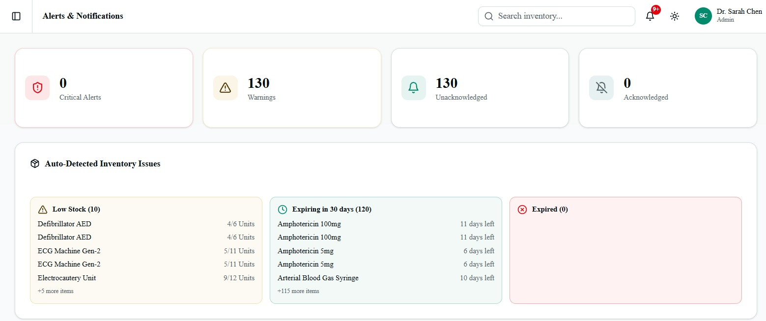
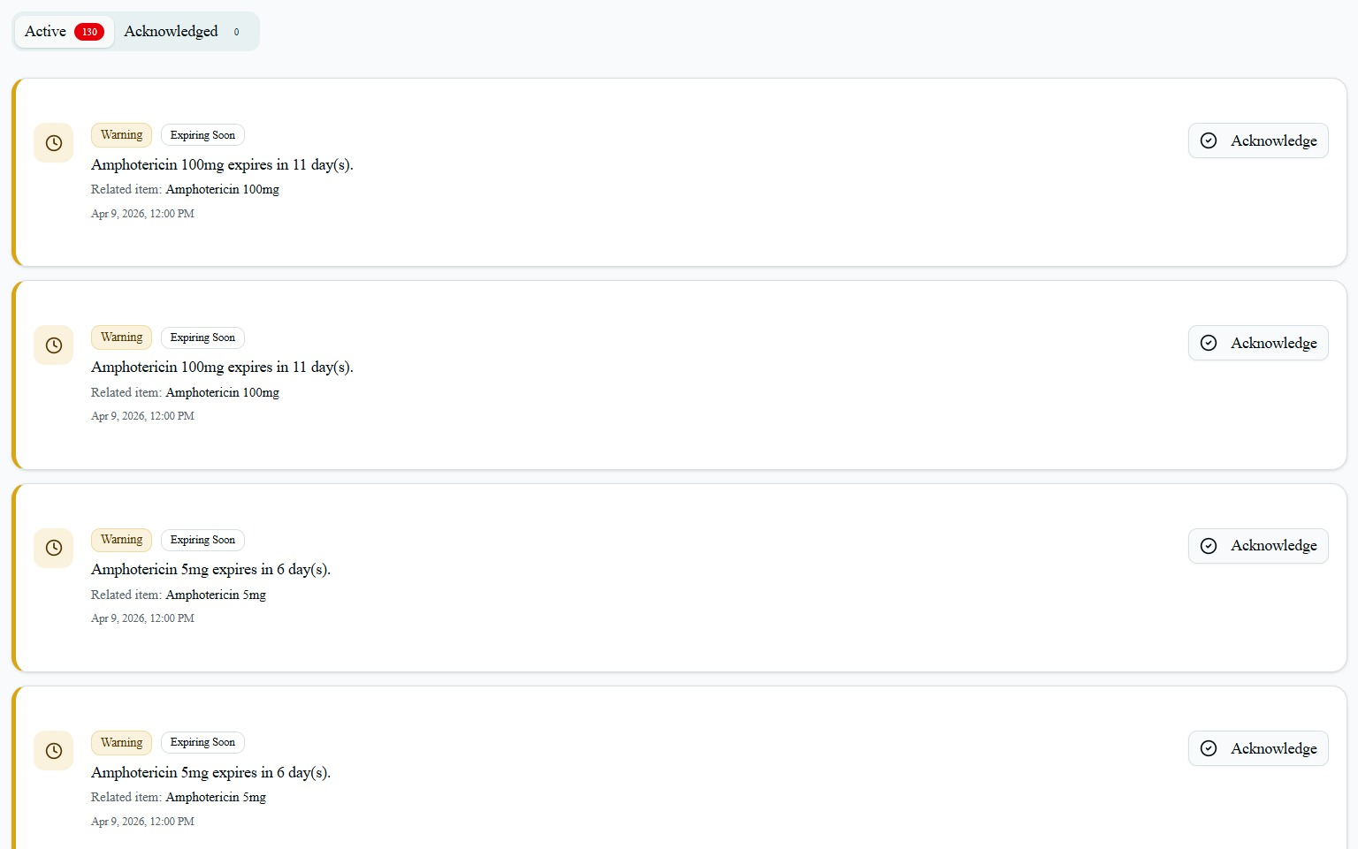
Key Feature — Alerts & Notifications
Severity-graded alert feed with full item context and acknowledgement workflow
Alert engine flags items crossing reorder thresholds and ML-predicted risk levels. Severity: Critical / High / Medium / Low. Each alert shows item name, quantity, reorder level and expiry date. Unacknowledged alerts are prioritised at top. Notifications via email, SMS or log.
4 severity levels
ML-triggered alerts
Acknowledgement workflow

Slide 17
06
AI & Predictive Analytics
LightGBM · CatBoost · LSTM · Ensemble · SHAP · Optuna

Slide 18
AI & Predictive Analytics — ML Models & Pipeline
Demand Forecasting
R² = 0.9998
CatBoost Benchmark (benchmark_results_catboost.json)
Model: LightGBM 4.0
Training R²
0.9998
PASS
14-day horizon per item. Lag features, rolling averages, seasonality flags and department-level trends. 5-fold CV.
MAE (units)
1.74
PASS
Training time
4.06 s (2.64 s best)
PASS
Classifier
Inference p99
Stockout Risk
1.59 ms
PASS
CV R² mean
Model: CatBoost + Random Forest
0.906 (5-fold)
—
Ensemble classifier flagging items likely to run out. Handles supplier_id, dept_id, category natively via CatBoost.
Advanced ML Pipeline
Expiry Risk
ROC curve
LSTM/GRU — TensorFlow/Keras, 14-day seq2seq, seasonal cycles
Model: Logistic Regression
Ensemble — 40% LightGBM + 30% CatBoost + 20% LSTM + 10% LR
Classifies items at risk of expiry based on current stock, usage rate and days-to-expiry. ROC curve via /api/expiry-risk.
Anomaly Detection — Isolation Forest on ingestion records
Optuna — Bayesian search; best params saved to best_params.json
SHAP + LIME — Global + per-item explanations via /api/explain/*

Slide 19
07
AI Agent System
CrewAI + local Ollama3 (llama3) — autonomous supply chain

Slide 20
AI Agent System — CrewAI + Ollama3 Agents
All agents run on local Ollama3 (llama3 @ localhost:11434) via CrewAI — no cloud LLM dependency required.
Data Ingestion Agent
EPIC-2 · TASK-201/202/203
Supply Chain Agent
EPIC-3 · TASK-303/304
Accepts CSV / inline records / external API source
Monitors stockout risk every N hours (configurable cadence)
Validates schema: item_id, quantity, timestamp required
Scores all suppliers using 5-factor weighted formula
Anomaly detection on ingested records (Isolation Forest)
Calculates EOQ-based order quantity per at-risk item
Quarantines suspicious records to admin audit table
Auto-creates Purchase Orders with approval routing
Triggers ML alert summary after each ingestion batch
Submits PO via EDI / email / API per supplier config
Delivery Tracker
EPIC-3 · TASK-305
Sentiment Analyzer
EPIC-3 · TASK-302
Creates delivery record on PO submission
NLP analysis of supplier review text
Ingests barcode scans, webhooks, manual status updates
Score: -1.0 (negative) → +1.0 (positive)
States: Pending → Shipped → In Transit → Delivered
Feeds into supplier scoring formula (10% weight)
Raises delay alert if delivery exceeds lead-time SLA
Cached per supplier for fast reuse in scoring calls
Dashboard view: /api/deliveries/status

Slide 21
AI Agent System — Approval Queue, Logs & Audit Trail
Manual Approval Queue (TASK-502)
Agent Logs & Audit System (TASK-401)
POs above cost threshold routed to approval queue
All agent actions persisted to agent_logs table
Reviewer sees: item, qty, supplier score breakdown, cost
Rolling retention policy keeps log footprint bounded
Approve or Reject with optional reviewer comments
GET /api/agents/logs — filter by agent, status, level
Audit trail records every decision with reviewer identity
Full-text search on task description + error payload
Auto-timeout: pending approvals >24h auto-processed
Pagination: limit + offset params supported
Frontend: /approval-queue — filter/search/pagination
GET /api/agents/dashboard — jobs summary + audit queue

Slide 22
08
Backend & API
35+ REST endpoints · Docker · Explainability layer

Slide 23
Backend Architecture & Data Analysis
Backend Framework
Database Layer
ML Integration
High-performance REST API endpoints for predictions, inventory, alerts & reports
PostgreSQL 15 as primary production database
Models trained and persisted as .pkl files for fast inference
Auto database setup and schema initialisation on startup
SQLite as local development fallback (no Docker needed)
Feature engineering pipelines for demand, stockout & expiry
Lifespan events for clean startup and graceful shutdown
Synthetic hospital dataset — ~7.3M daily consumption records
Prediction endpoints integrated directly into dashboard views
Key API Endpoint Groups
ML Predictions
/api/demand-forecast?item_id=N
Explainability
/api/explain/item/{id}
/api/stockout-risk
/api/explain/prediction/{id}
/api/expiry-risk
/api/model-overview
/api/ensemble-forecast
/api/model-comparison
/api/anomalies/recent
Agents & Procurement
/api/agents/supply-chain/optimize
Deliveries & Audit
/api/deliveries/status (GET/POST)
/api/purchase-orders (GET/POST)
/api/deliveries/sync
/api/approval-queue/{id}/decision
/api/agents/logs
/api/suppliers/scoring
/api/admin/ingestion-audit

Slide 24
09
Development Workflow
Epics · sprints · Git branching · Definition of Done

Slide 25
Development Workflow — Sprint Timeline & Git Standards
Project Timeline — 3 Epics across 4 Sprints
EPIC-1
Sprints 1–2
EPIC-2
Sprint 3
EPIC-3
Sprint 4
Frontend
Epic
81 pts
29 pts
63 pts
—
TASK-101 → 107
TASK-201 → 203
TASK-301 → 305
FE-501 → 504
LightGBM · CatBoost
LSTM · Ensemble
Optuna · SHAP
CrewAI setup
CSV/API ingest
Validation + Anomaly
Supplier scoring
NLP sentiment
PO + Delivery track
Agent Dashboard
Approval Queue
Cleanup & sync
Completed
Completed
Completed
Completed

Slide 26
Development Workflow — Git Branching & Definition of Done
Branch Naming & Commit Format
Definition of Done (all required before merge)
Format: task/{TASK_ID}/{short-description}
Acceptance criteria fully implemented
task/TASK-101/lightgbm-migration
Unit tests added and passing (95%+ coverage target)
task/TASK-202/data-ingestion-agent
Full backend regression test suite passing
task/TASK-303/supply-chain-scorecard
IMPLEMENTATION_TICKETS.md + README updated
Commit format: [TASK-XXX] Brief description
Changes committed to epic branch with proper format
[TASK-101] Create LightGBM training pipeline
Epic branch pushed only after ALL tasks in epic done
[TASK-102] Add early stopping + benchmarking
[TASK-303] Implement supplier scoring module
PR opened only after full regression passes

Slide 27
10
Conclusion & Roadmap
Industry impact, achieved results and future upgrades

Slide 28
Conclusion — Industry Impact & Future Roadmap
Industry Impact
Achieved Results
Stockout Reduction
0.9998
1.74 units
ML risk flagging surfaces at-risk items 14 days ahead — enabling proactive restocking before shortages.
CatBoost R²
MAE
Expiry Waste Cut
1.59 ms
173+ pts
Expiry risk model identifies items expiring within configurable windows — targeting the 8–10% industry waste rate.
Inference p99
Story points
35+
3 of 3
Cost Optimisation
API endpoints
Epics completed
Automated PO generation and supplier scoring eliminates over-ordering and emergency procurement premiums.
Future Roadmap
Patient Safety
Model retraining with real hospital EHR data
Real-time alerts ensure critical medicines (blood products, surgical supplies) are available — reducing care interruptions.
Confidence scoring + uncertainty estimation per prediction
Multi-hospital / multi-tenant support + RBAC
Real EDI/HL7 supplier integration for live PO submission
Mobile PWA for ward-level alerts and barcode scanning

Slide 29
Thank You
Questions & Discussion
Tenzin Kunga
Saunak Mahapatra
Saumitra Purkayastha
23BTRCL088
23BTRCL077
23BTRCL113
github.com/tampered-sin/v0-ahimp | branch: develop
AHIM — AI-Powered Hospital Inventory Management | Academic Project 2025–26

